Slide 1

Mzkit User Manual
BioNovoGene m/z Data Toolkit User Manual
BioNovoGene Bio-Pharm Technology Co., Ltd
Present By: BioDeep R&D Department
E-Mail: R&D@biodeep.cloud

Slide 2
Introduction
The main function of Mzkit includes:
Raw Data Viewer
Metabolite Feature Annotation
Mulecular Networking
Open Source M/z Raw Data File Format Supports:
mzML, mzXML, imzML, mzPack, netCDF, HDF, Mgf

Slide 3
LICENSE
Mzkit application and its source code is distributed under the MIT open source license
Source Code:
https://github.com/xieguigang/mzkit
Downloads:
http://www.biodeep.cn/downloads?lang=en-US

Slide 4
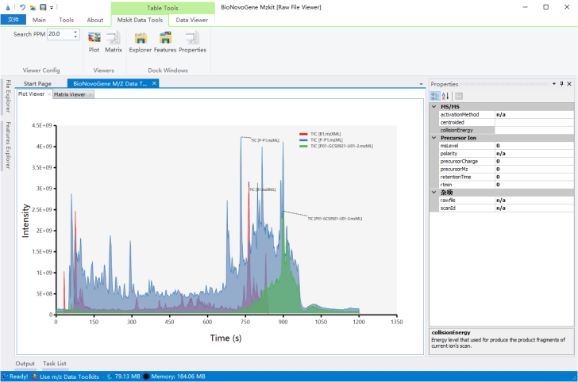
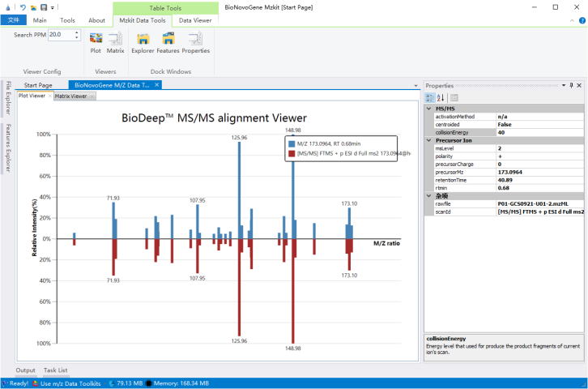
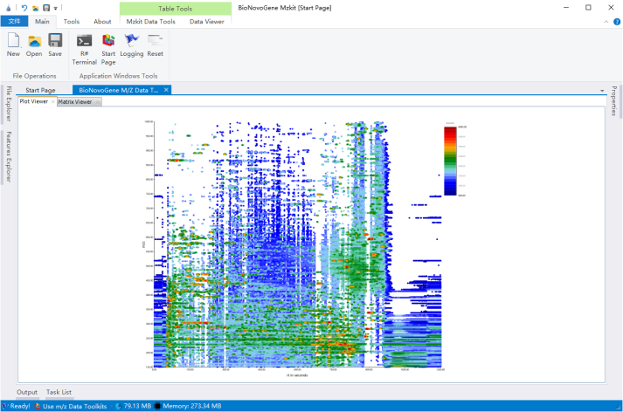
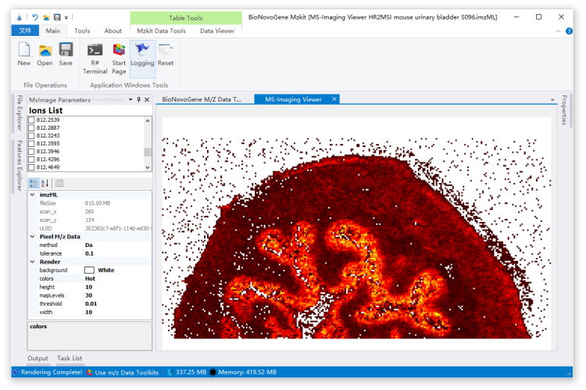
Screenshots
a. Chromatography
b. Spectrum
c. 2D Scatter
d. MS-Imaging

Slide 5
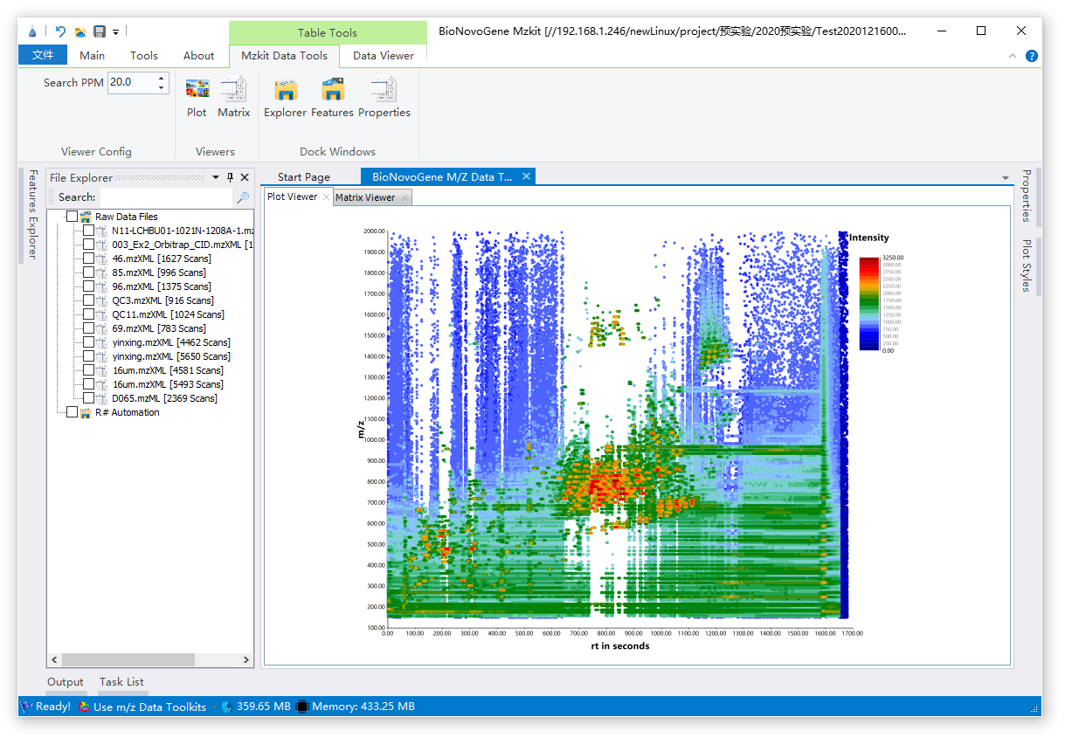
Main Screen
Toolkit Ribbon
Data Explorer
Content Properties
Content Viewer
Status Toolstrip
The main screen page of Mzkit application.

Slide 6
MS-Imaging Viewer
Mzkit application and its source code is distributed under the MIT open source license
Source Code:
https://github.com/xieguigang/mzkit
Downloads:
http://www.biodeep.cn/downloads?lang=en-US

Slide 7
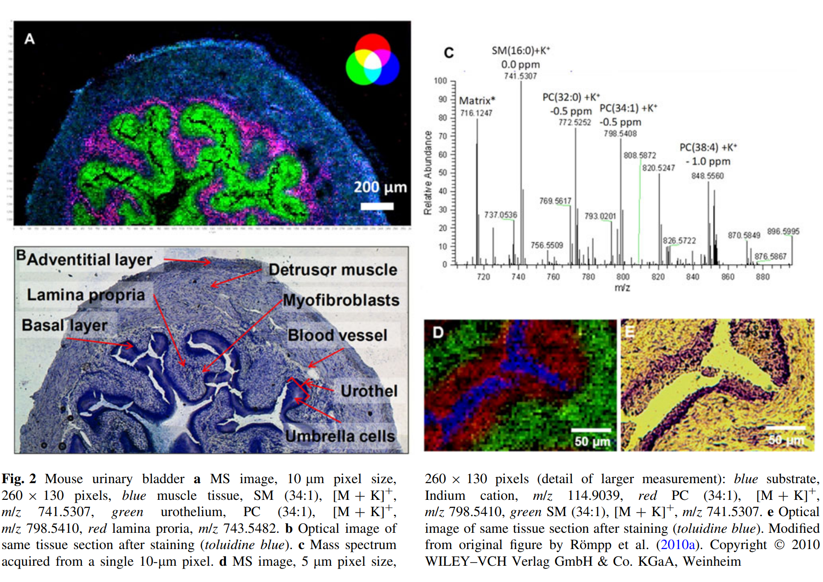
Introduce MS-Imaging
Mass spectrometry imaging (MSI) is a technique used in mass spectrometry to visualize the spatial distribution of molecules, as biomarkers, metabolites, peptides or proteins by their molecular masses. By choosing a peak in the resulting spectra that corresponds to the compound of interest, the MS data is used to map its distribution across the sample. This results in pictures of the spatially resolved distribution of a compound pixel by pixel.
Römpp A, Spengler B. Mass spectrometry imaging with high resolution in mass and space.
Histochemistry and Cell Biology. 2013 Jun;139(6):759-783.
DOI: 10.1007/s00418-013-1097-6.

Slide 8
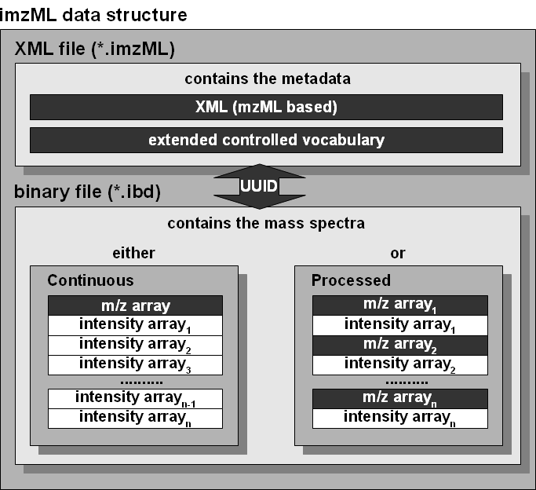
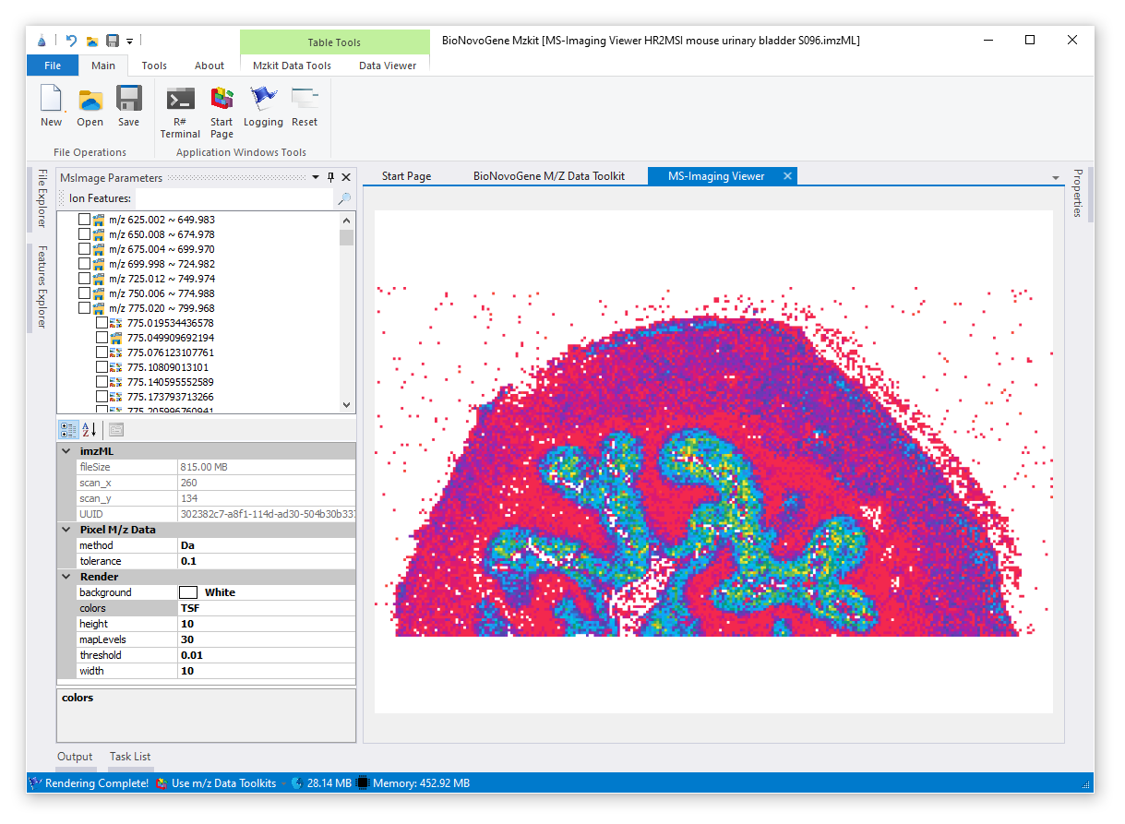
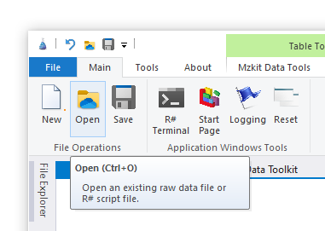
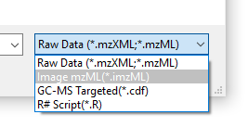
imzML for MS-imaging
Mzkit Supports the imzML file format for view ms-imaging content.
Steps for view MS-imaging
in Mzkit:
[Main] Open
Select imzML format
Select ion for view image

Slide 9
MS-imaging
Ion Explorer
Select one ion or multiple ions at here.
Context menu on mouse right click for run image rendering.
Content Viewer
View MS-Imaging rendering image output
Render Options
Tweaks of the MS-Imaging rendering options
MS-imaging in Mzkit

Slide 10
View GC-MS Targeted
Mzkit application and its source code is distributed under the MIT open source license
Source Code:
https://github.com/xieguigang/mzkit
Downloads:
http://www.biodeep.cn/downloads?lang=en-US

Slide 11
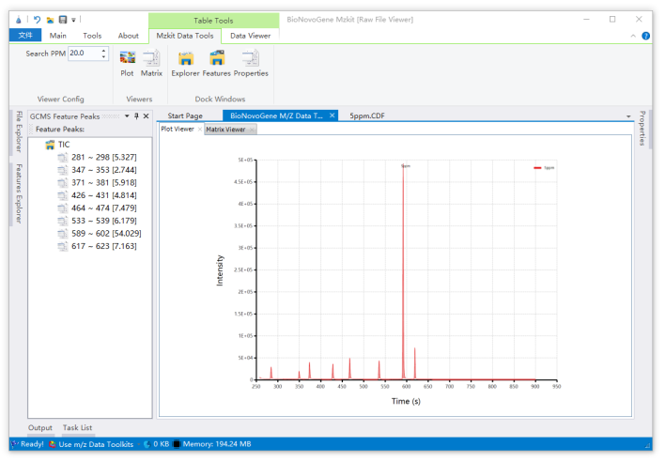
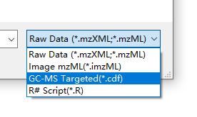
View GC-MS Targeted
The GC-MS targeted data in CDF file format is supported in Mzkit.
View GC-MS targeted data in Mzkit includes view TIC data and SIM ions for metabolite quantification.
Steps for view GC-MS targeted data
in Mzkit:
[Main] Open
Select CDF format
View GC-MS data in Mzkit

Slide 12
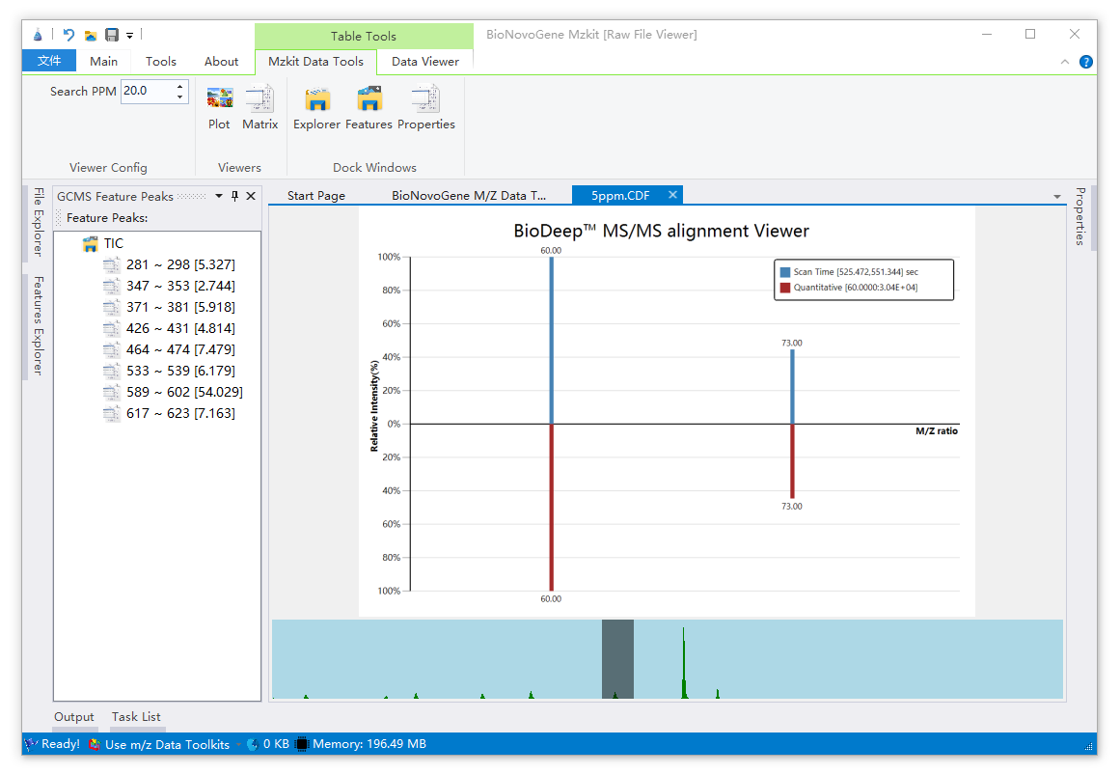
View GC-MS Targeted
Content Viewer
View the mass spectrum of the selected ion peak
Feature Explorer
Select one ion at here for view mass spectrum plot data.
Select TIC node for view TIC plot of the current GC-MS experiment
Peak Explorer
View Ion peak on TIC at here, and select rt range with mouse drag.
View SIM Ions Of GC-MS Targeted

Slide 13
View LC-MS/MS Targeted
Mzkit application and its source code is distributed under the MIT open source license
Source Code:
https://github.com/xieguigang/mzkit
Downloads:
http://www.biodeep.cn/downloads?lang=en-US

Slide 14
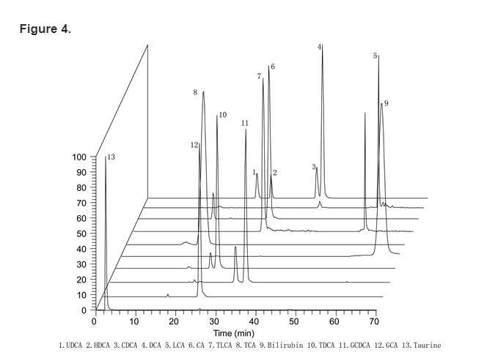
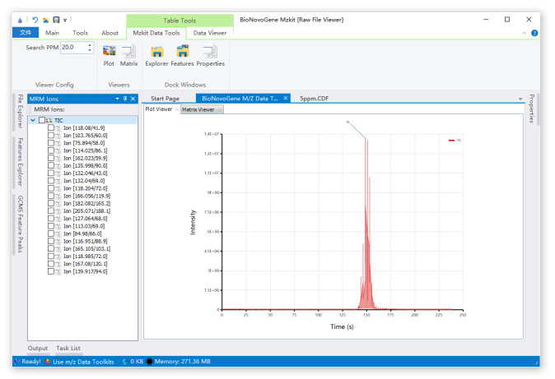
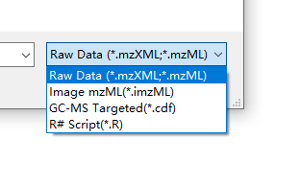
View LC-MS/MS Targeted
MRM stands for Multiple Reaction Monitoring.
In MRM, a specific ion (precursor ion) is selected in Q1 (first stage MS) from among various ions ionized by the ionization probe, the ion is destructed (collision-induced dissociation) in the collision cell (Q2, collision chamber), and a specific ion is detected from among the destructed ions (product ions) in Q3 (second stage MS).
Multiple channels can be set in one measurement.
Steps for view LC-MS/MS targeted data
in Mzkit:
[Main] Open
Select mzML format
View LC-MS/MS data in Mzkit

Slide 15
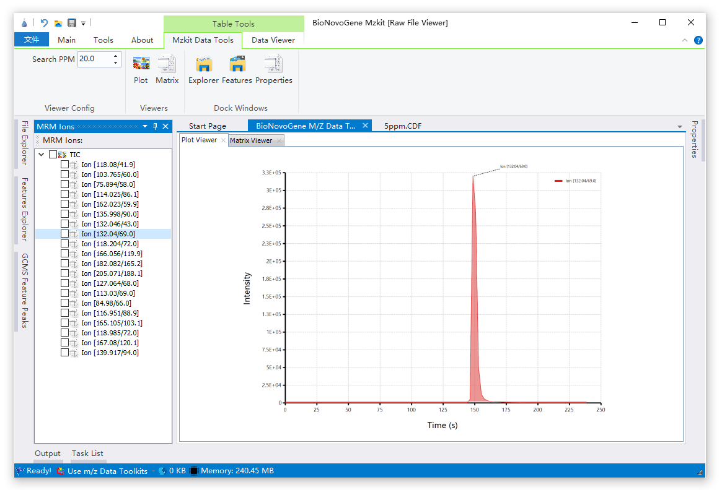
View LC-MS/MS Targeted
Content Viewer
View the mass spectrum of the selected ion peak
Feature Explorer
Select one ion pair at here for view extracted ion chromatography
plot data.
Select TIC node for view TIC plot of the current LC-MS/MS experiment
View LC-MS/MS Targeted MRM data in Mzkit

Slide 16



感谢观看
Thank you for your attention
苏州帕诺米克生物医药科技有限公司
地址：江苏省苏州市工业园区新平街388号22幢2层
电话：0512-62959105
邮箱：info@bionovogene.com
网址：https://www.bionovogene.com www.biodeep.cn
科研服务订阅号
科研服务公众号
健康服务公众号

